Slide 1

Development of a secure application
Mentor: as. univ. M. Găidău
Mentor: c. M. Mandis
Students: Ursu Vlad
Botezatu Marius
Bucătaru Daniel
Ciumac Alexei
Telug Anatolie
2023-2024

Slide 2

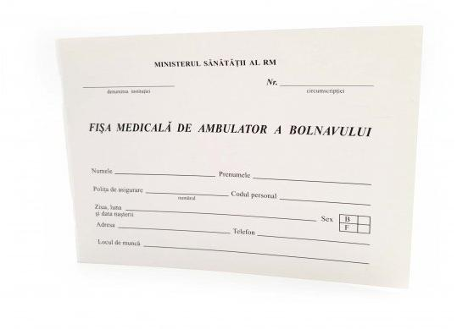
Identified problem
Inefficient data storage
Precarious physical storage
Not clear handwritings

Slide 3

Main Concept
The Medical History (SanatOS) Web App
is a web-based application designed
to provide patients and healthcare providers
with a secure and efficient platform for
managing and accessing medical records.

Slide 4
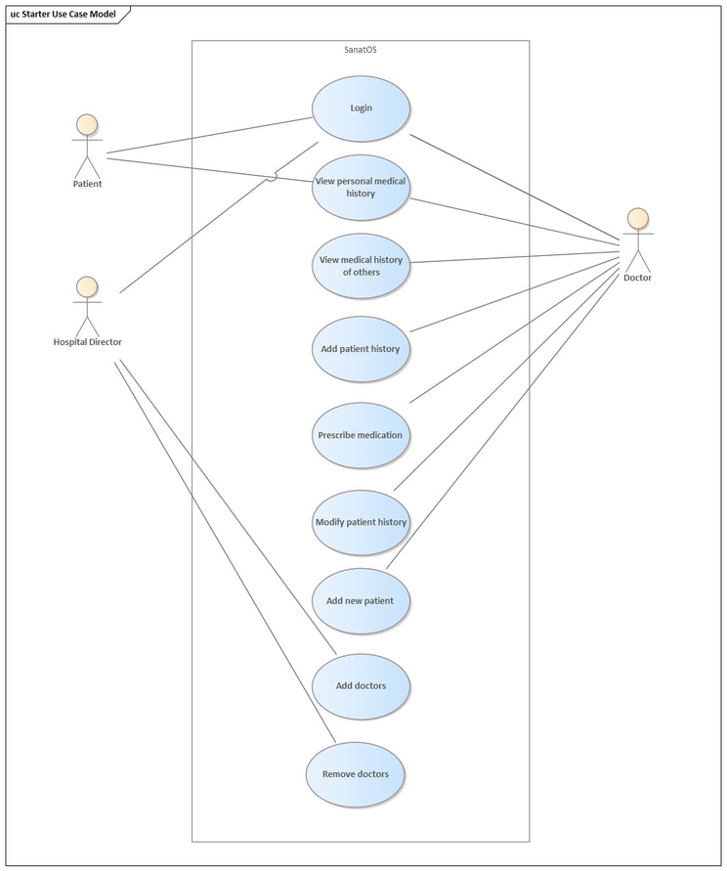
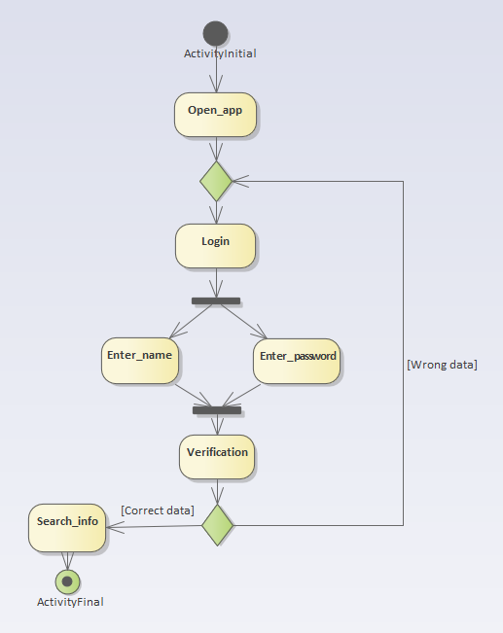
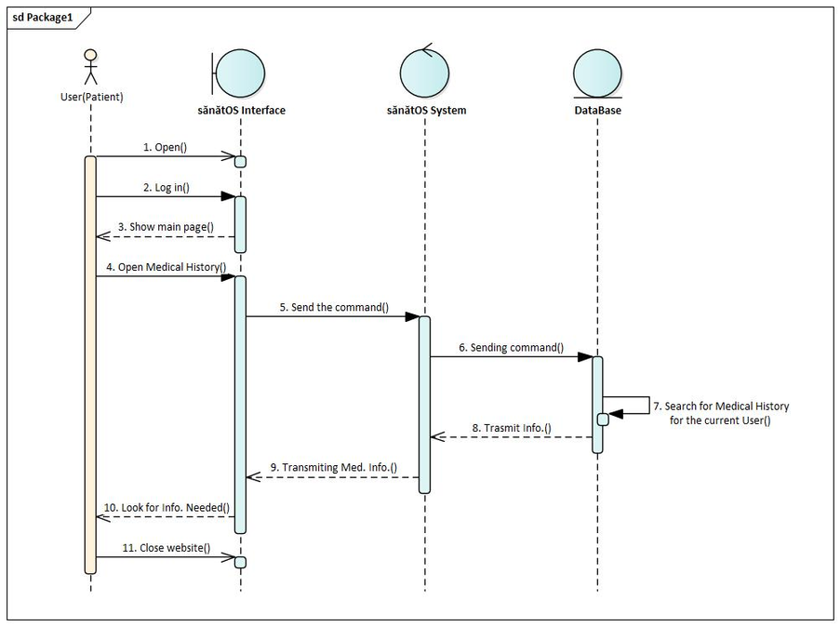
Creating the high-level structure

Slide 5
Application Architecture
three-tier architecture
1. Presentation Layer : The user interface is built using HTML, CSS, and TypeScript,
with a responsive design for mobile and desktop users. The frontend is developed
using React.js and Tailwind CSS, providing an interactive and intuitive user experience.
2. Application Layer : This layer comprises the core application logic. It is implemented
in Python also using Flask framework.
3. Data Layer : Data is stored in a relational database using MySQL. Flask SQLAlchemy is
used to interact with the database.

Slide 6
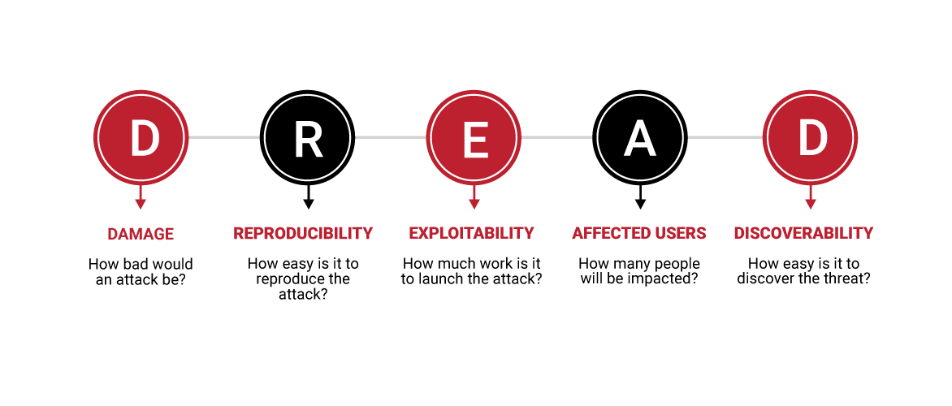
Security and safety
● User authentication is handled through Flask, which supports both
username-password and two-factor authentication using Flask.
● Data transmission is secured with HTTPS to protect sensitive medical records.
● Patient and healthcare
provider roles have different
access levels, ensuring that
sensitive data is protected.
● Encrypted data storage.
8/10
6/10
6/10
9/10
8/10

Slide 7
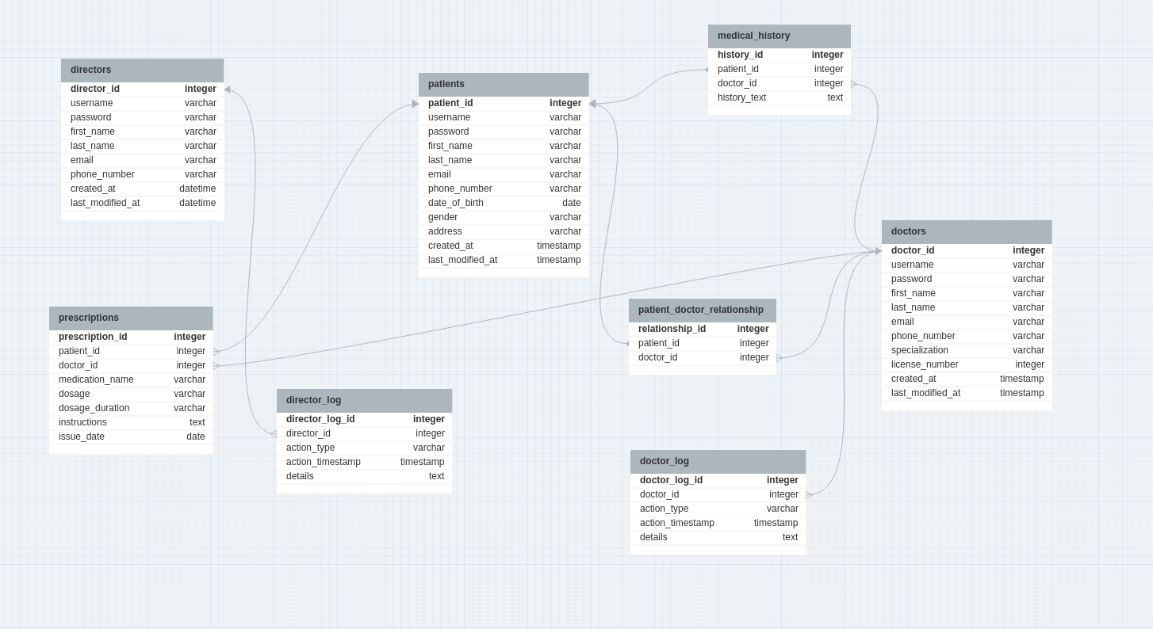
DB structure
User profiles, patient information
and medical records are securely
stored in the MySQL database.

Slide 8
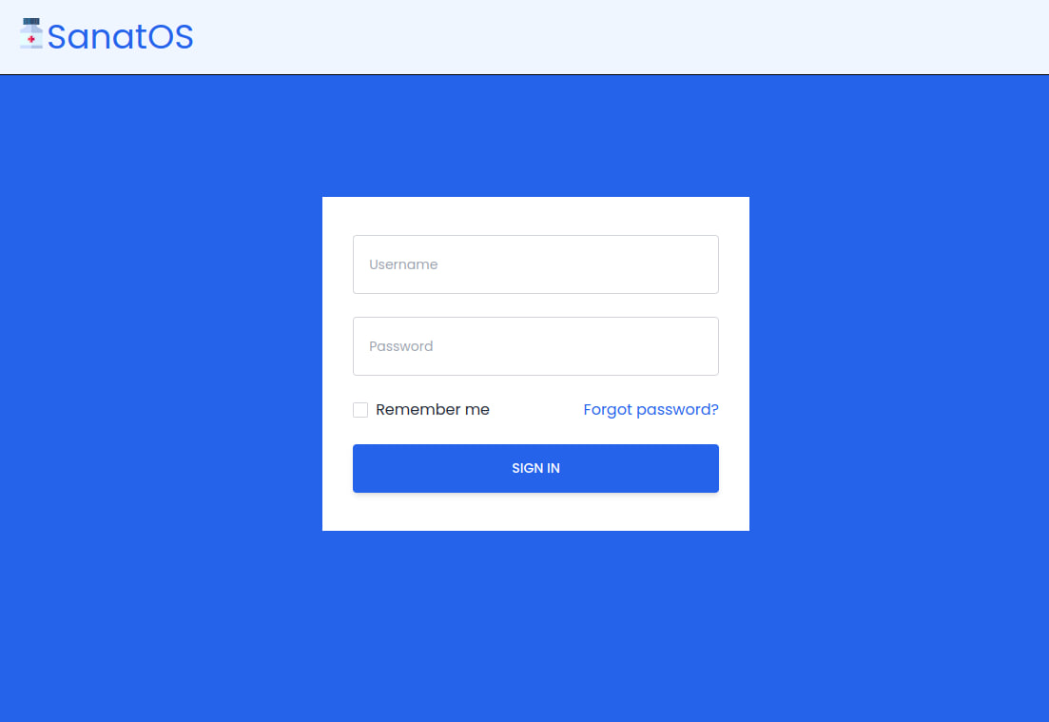
Front-End and Functionality
After clicking the login button
you can see the login form
that require correct Email and password.

Slide 9
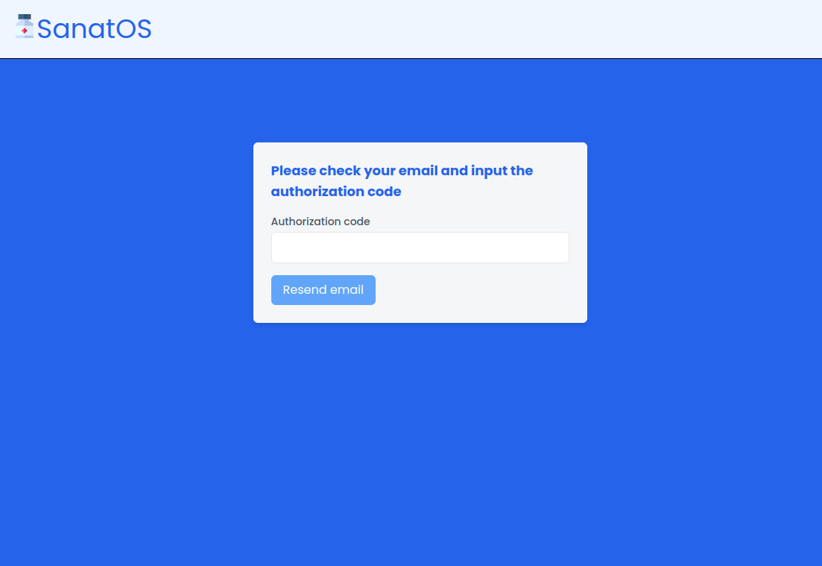
Front-End and Functionality
After that you should enter the authorization code which was sent to your email.
So it is 2-factor authentication.

Slide 10
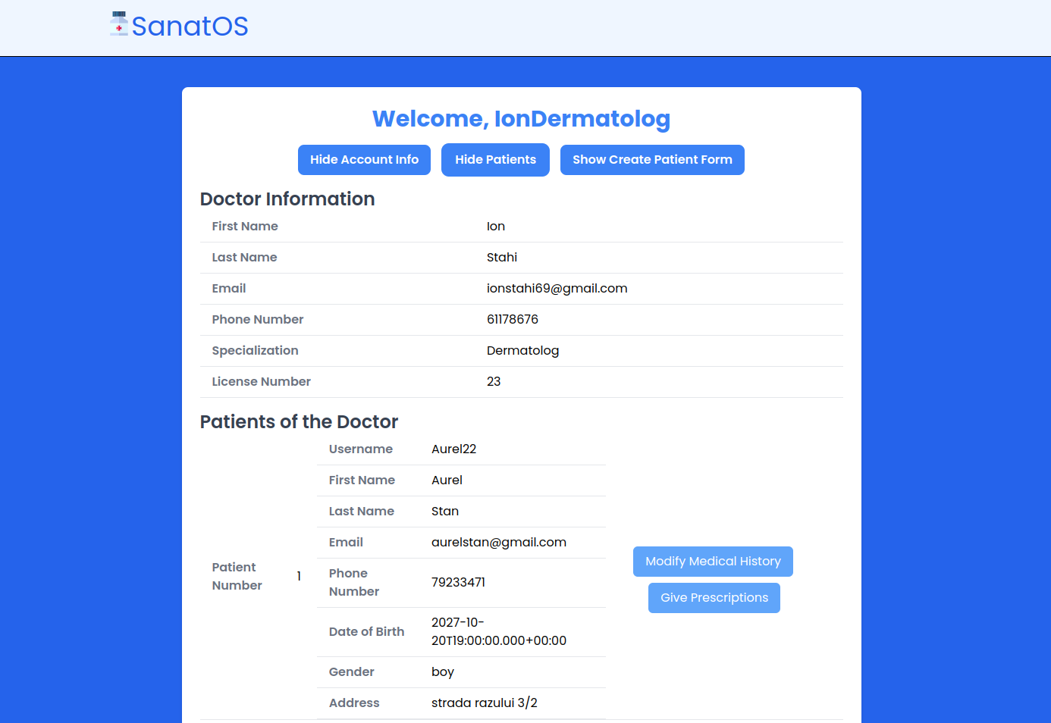
Front-End and Functionality
If you are a doctor and entered the Email
and password correctly you can see the
doctor profile with list of your patients.

Slide 11
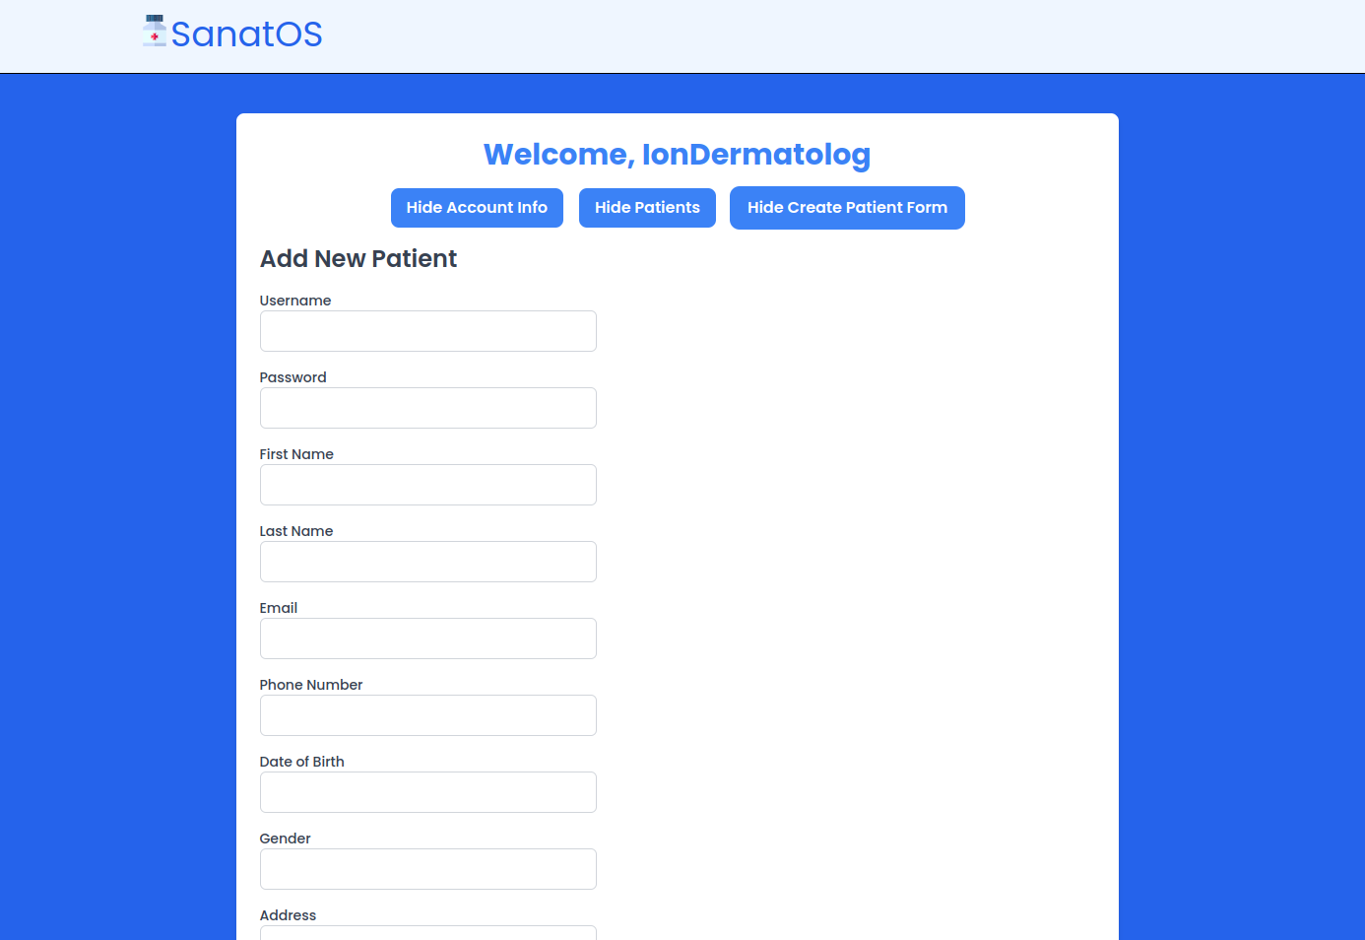
Front-End and Functionality
Here is the functionality of adding the patients. All patient data will be entered
by the doctor and will be stored securely in the database.

Slide 12
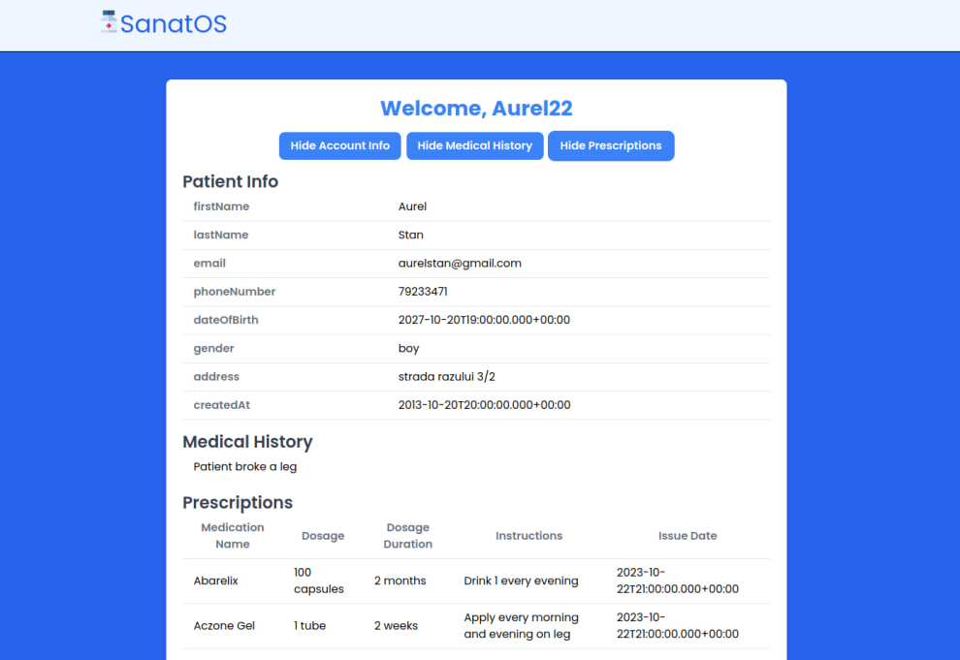
Front-End and Functionality
If you are a patient and entered the Email and password correctly you can see your personal data, Medical History and Prescriptions from the doctors.
Note that you can not have access to the other patients profiles.

Slide 13
Conclusion
During the semester we have created the lite version of our secured healthcare app sanatOS. We implemented frontend(simple and clear), backend(logic and performant) and database(secured).
It was helpful experience for us to develop both hard skills and soft skills.

Slide 14
Thank you for your attention!

